Slide 1
GoldDigger.com
By: Brian, Zack, & Mike

Slide 2
Requirements
People who want to use the system can create accounts and find matches
User can log in and discover matches based on a score
The top three matches are displayed at first
If the user is not satisfied with the matches, they can click a button to display the next highest matches

Slide 3
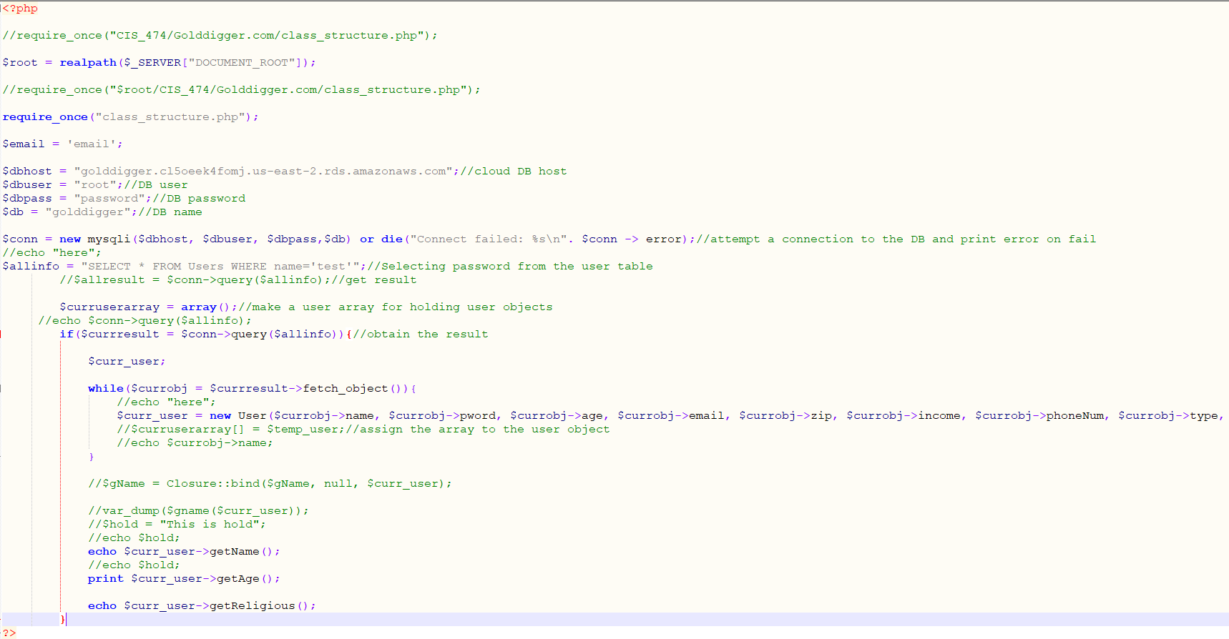
TESTS: test.PHP

Slide 4
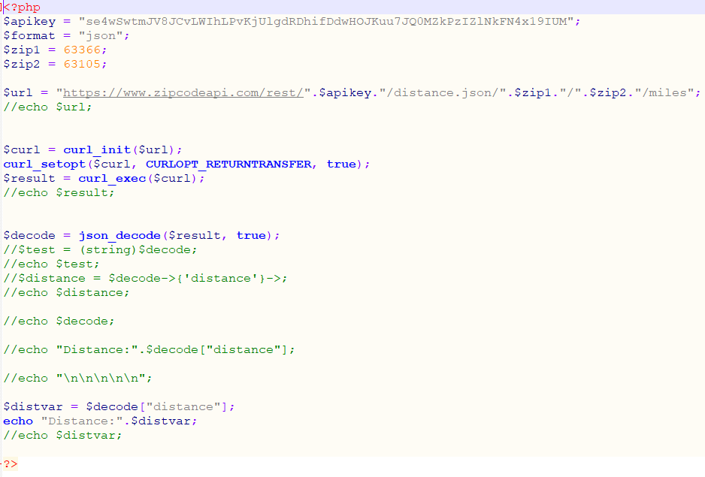
TESTS: ZIPTEST.PHP

Slide 5
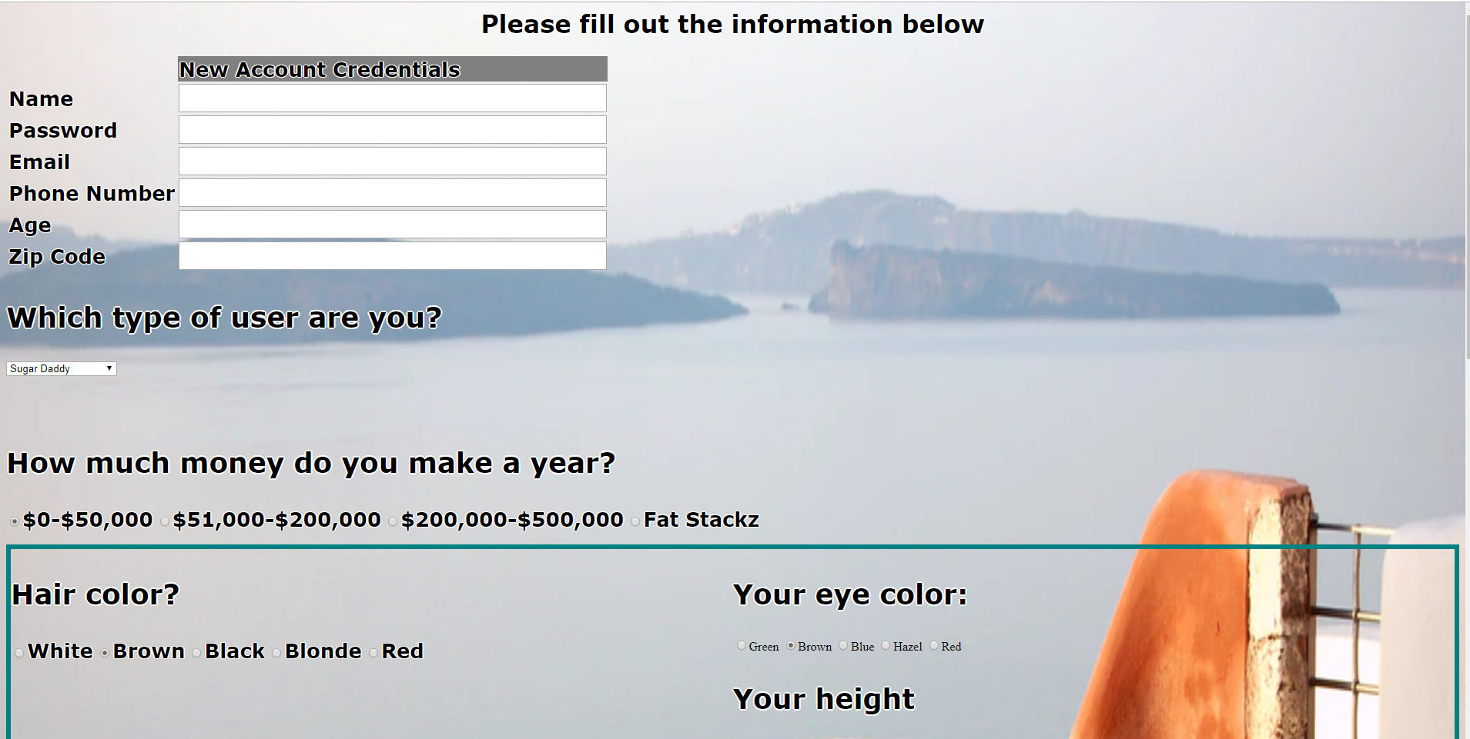
REGISTRATIONPAGE.HTML

Slide 6
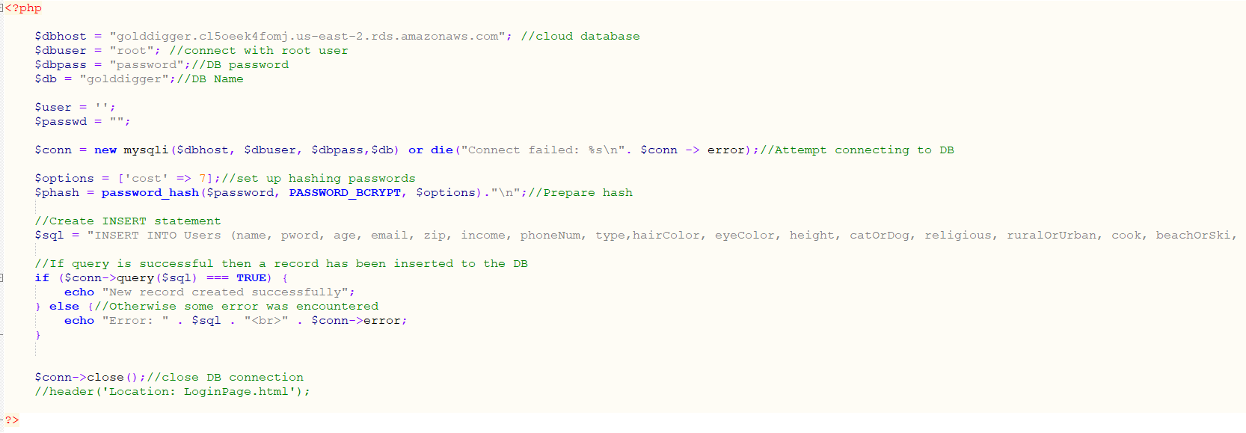
CreateACCOUNT.PHP

Slide 7
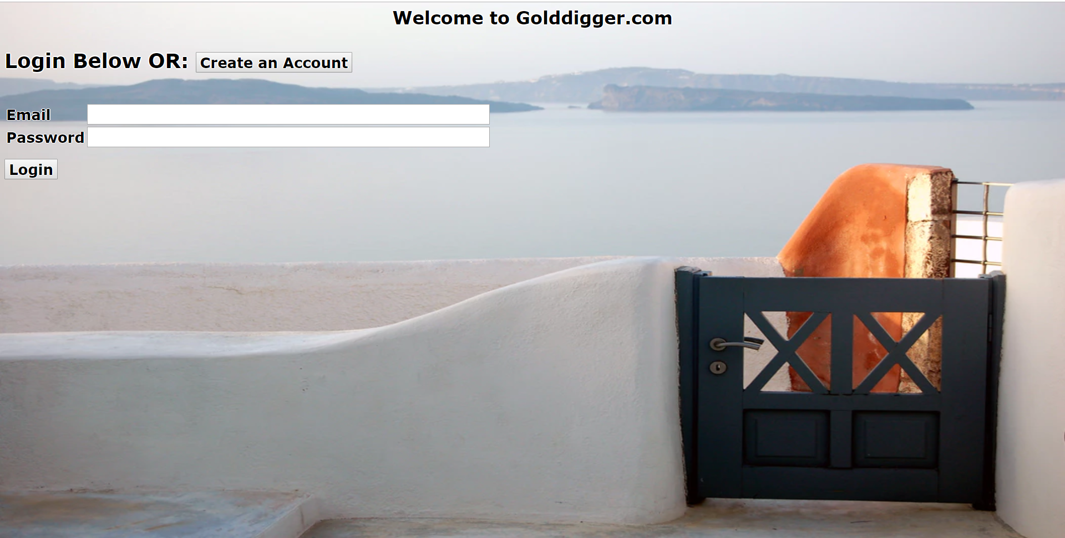
LoginPage.HTML

Slide 8
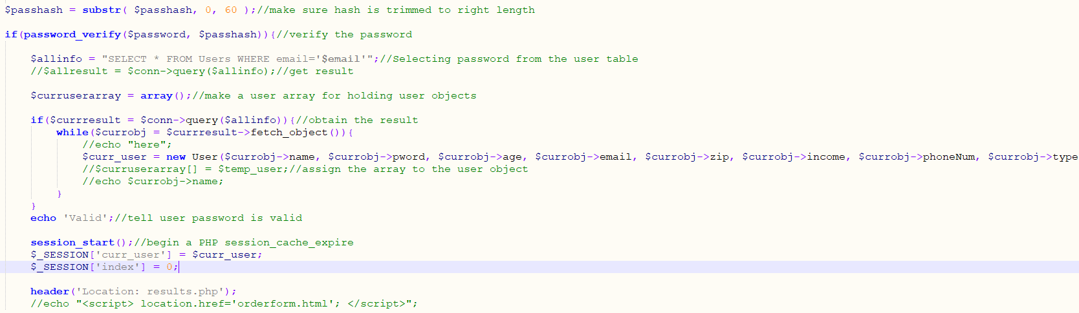
LoginPage.php

Slide 9
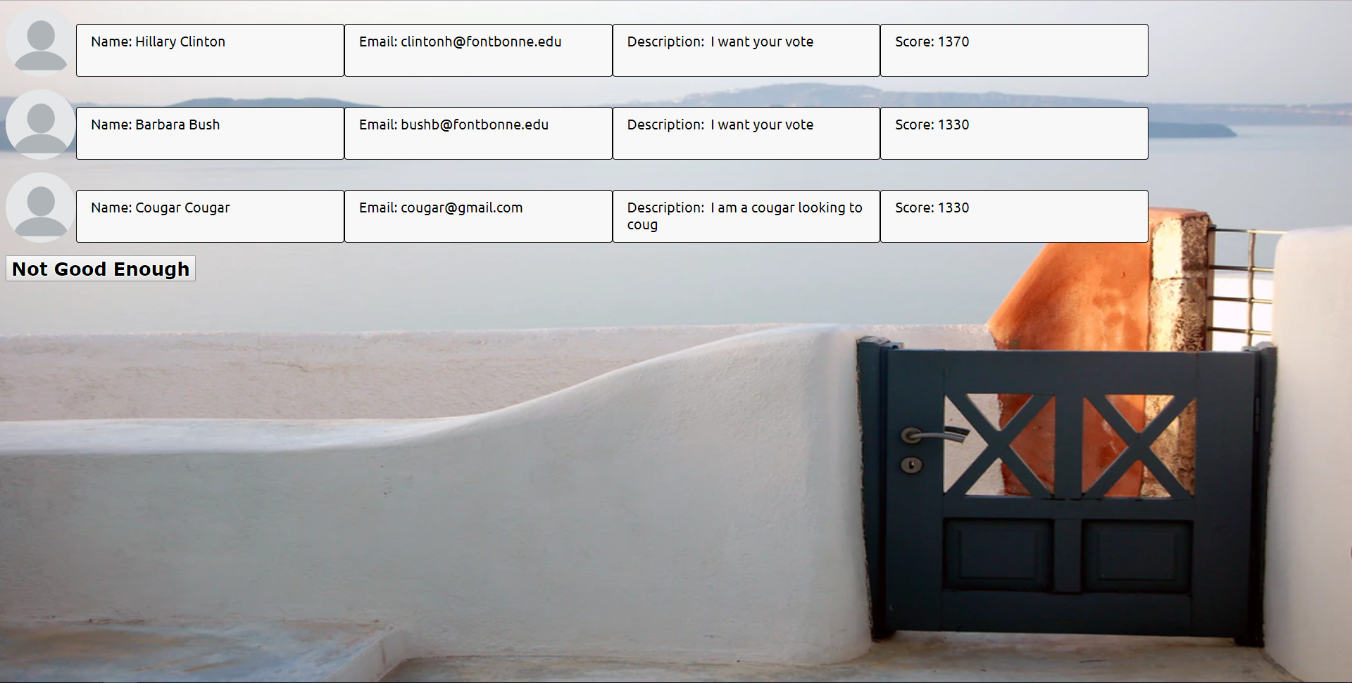
RESULTS.PHP

Slide 10
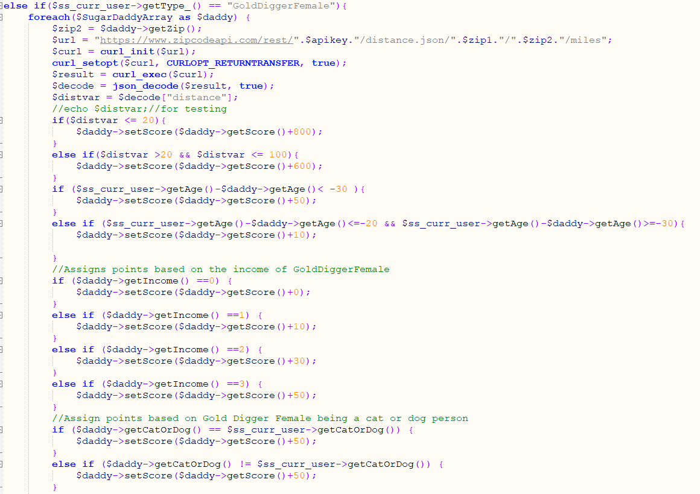
RESULTS.PHP

Slide 11

DEMO

